Slide 1
ECE 5351 Biomedical Signal Processing: Assignment 3
Ahmed Bayoumi
Dr. Mary Baker

Slide 2
Problem 4.15
ECG data are often used to determine the heart rate by measuring the time interval between the peaks that occur in each cycle known as the R wave. To determine the position of this peak accurately, ECG data are first prefiltered with a bandpass filter that enhances the R wave and the two small negative peaks on either side, the Q and S wave. The three waves together are termed the QRS complex. Load file ECG_noise.mat, which contains 10 s of noisy ECG data in variable ecg. Filter the data with a 65-coefficient FIR bandpass filter to best enhance the R-wave peaks. Use the tapering window of your choice. (Note that it is not possible to eliminate all the noise, just improve the identification of the peaks.) Determine the low and high cutoff frequencies empirically, but they will be in the range of 4–24 Hz. The sampling frequency is 250 Hz.
- 10 s of noisy ECG data sampled at 250 HZ
Enhancing the R wave
Design a 65-coefficient FIR bandpass best enhance them (window optional)
Hint: 4–24 Hz.

Slide 3
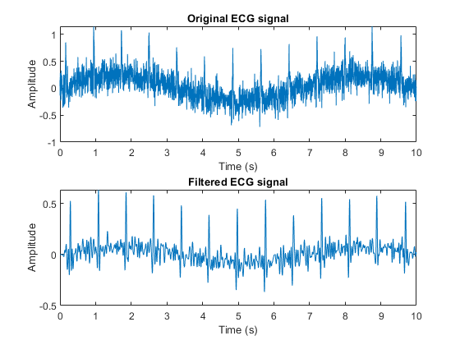

Slide 4
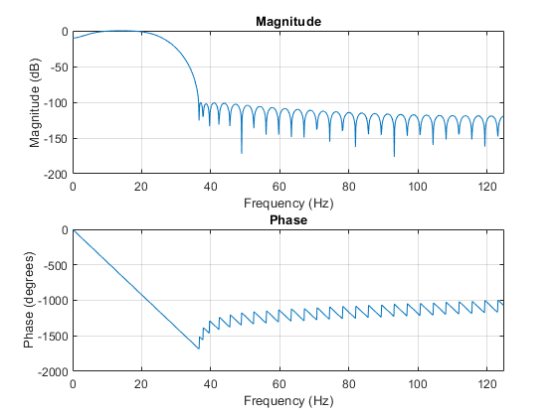

Slide 5
Problem 4.24
This problem demonstrates a comparison of a causal and a noncausal IIR filter implementation. Load file Resp_noise1.mat containing a noisy respiration signal in variable resp_noise1. Assume a sample frequency of 125 Hz. Construct a 14thorder Butterworth filter with a cutoff frequency of 0.15 fs/2. Filter that signal using both filter and filtfilt and plot the original and both filtered signals. Plot the signals offset on the same graph to allow for easy comparison. Also plot the noise-free signal found as resp in file Resp_noise1.mat below the other signals. Note how the original signal compares with the two filtered signals, in terms of the restoration of features in the original signal and the time shift.
- Comparison of causal [filter()] & noncausal [filtfilt()] IIR filter implementation
Filter noise from a respiration signal w/ f_{s} = 125Hz
Design a 14th order IIR butterworth filter w/ f_{c} = 9.375

Slide 6
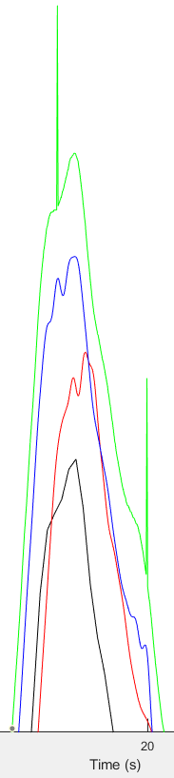
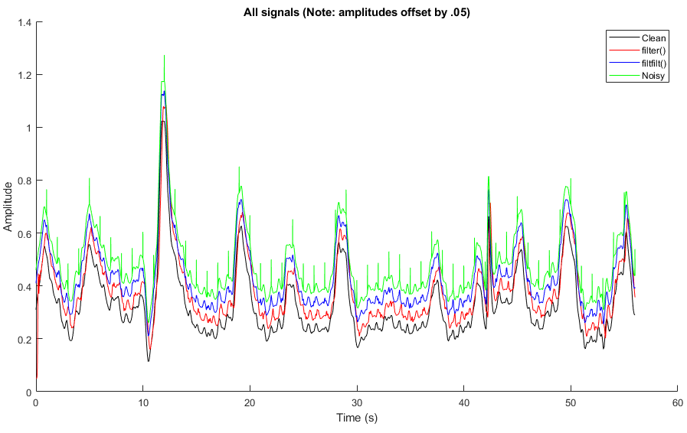
Zoomed in on the right
Causal IIR filters introduce phase distortion (shifts signal in time)

Slide 7
